Slide 1

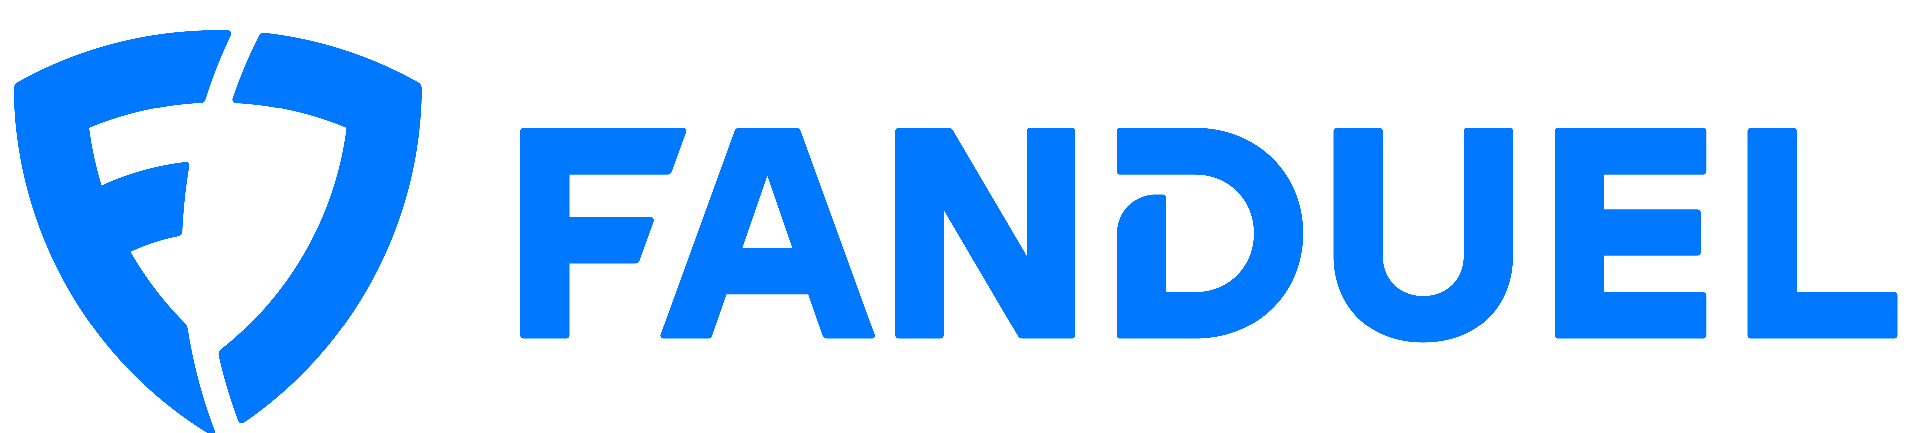

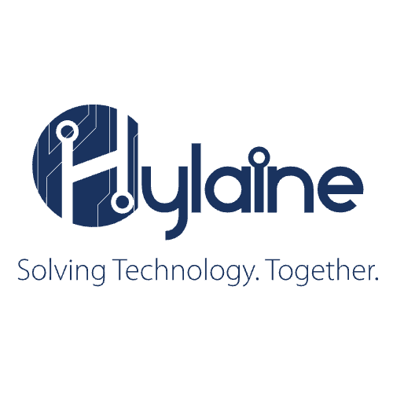

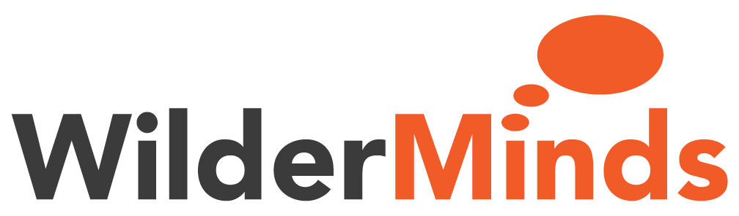
Platinum Sponsors
Gold Sponsor
Silver Sponsors
FCS Innovation Academy
Dedicated To Excellence In Education

Slide 2
Transforming Legacy to Leading Edge
Dive into the World of Application Modernization
Presented by Chris Steele

Slide 3
Quick thank you!
Applause ☺

Slide 4

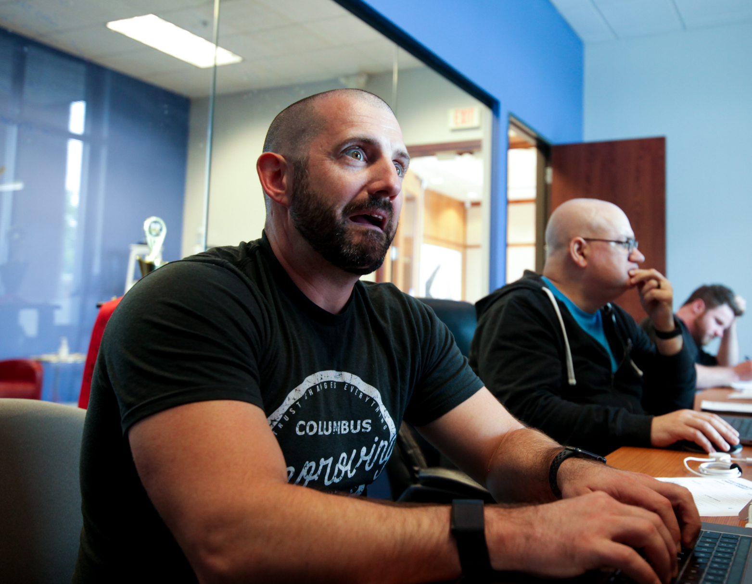
About Me

Slide 5
Today’s Focus
Understanding Application Modernization
Challenges of Legacy Applications
Modernization Strategies
Getting Started
Closing

Slide 6
Understanding Application Modernization

Slide 7
Microsoft
Application modernization is the process of updating current apps and data to a cloud-first model to align with business needs. This may involve migrating to the cloud
Notes:
https://azure.microsoft.com/en-us/resources/cloud-computing-dictionary/what-is-application-modernization

Slide 8
AWS
Modernization means taking your application environment in the form that it’s in today (most likely, legacy and monolithic) and transforming it into something that is more agile, elastic, and highly available

Slide 9
IBM
Application modernization is the process of taking existing legacy applications and modernizing their platform infrastructure, internal architecture, and/or features.

Slide 10
Chris Steele
Application modernization is the process of updating your technical landscape to best support your business needs using current industry norms.

Slide 11

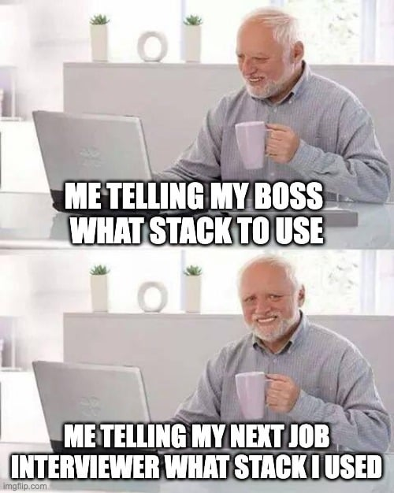
What it’s not

Slide 12
Why should you care?
Thrive in fast-paced and digital-centric business environment
Addresses the limitations of legacy systems
Positions businesses for future growth and innovation
Enhances security, cost-efficiency, and competitiveness
Notes:
Enhanced performance
Cost reduction
Scalability
Security
Etc...

Slide 13
Why is this important?
Strategic response to challenges and opportunities
Market dynamics
Agility and innovation
Regulatory changes
Cost efficiency
Notes:
Market Dynamics: Discuss how market trends, customer preferences, and competitive forces continually evolve. For example, customers today may expect seamless mobile experiences and real-time services, which legacy systems may struggle to provide.
Agility and Innovation: Emphasize the importance of agility and innovation in staying ahead in the market. Legacy systems can be a barrier to rapid adaptation and innovation, making modernization a strategic imperative.
Regulatory Changes: Mention how regulatory requirements can change over time, and legacy systems may struggle to comply with updated regulations. Modernization can help ensure compliance and data security.
Cost Efficiency: Discuss how modernization can lead to cost savings in the long run by reducing maintenance expenses and enabling more efficient resource utilization.

Slide 14
Challenges of Legacy Applications

Slide 15
Common Issues with Legacy Applications
Cost Management
Data Integration
Agility
Scalability
Security
Technical Debt
Lack of Talent
Notes:
https://amzurtech.medium.com/key-drivers-of-legacy-application-modernization-1a18264b5091
https://www.redhat.com/en/topics/application-modernization?pfe-mvvuojgvn=Business+leaders
Cost Management – manual processes, maintenance, downtime
Data Integration – unable to meet data compliance (General Data Protection Regulation (GDPR), Health Insurance Portability and Accountability (HIPAA)

Slide 16
Impact on Business
Business Agility
Security Breaches
Increased Cost
Notes:
Business Agility – speed to market, adapt to changes,
Recent security breaches https://tech.co/news/data-breaches-updated-list:
Fortinet (cybersecurity) – 775,000 customers
Franklin County – Ransomware (Rhysida) – 2MM - 6tb of data – City systems are down

Slide 17
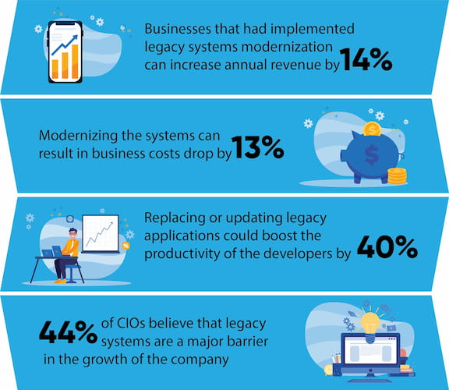
Some Stats
Data Science Central
Notes:
Resource: https://www.datasciencecentral.com/the-true-value-of-legacy-systems-modernization-for-businesses/

Slide 18
Modernization Strategies

Slide 19
Strategies
Rehost
Replatform
Refactor
Replace
Retire
Faster migration
Remove obsolete components
Reduces technical landscape
Cost savings
Typically, automated
Still requires infrastructure maintenance
Leveraging cloud services
Minor code changes
Structure largely the same
Restructuring of code
Deep cloud integration
Requires rearchitecting
Start from scratch
Tech debt refresh
Can take the longest

Slide 20
Strategy Effort
Effort
Rehost
Replatform
Refactor
Replace
Retire

Slide 21
Retire
Remove obsolete components
Reduces technical landscape
Cost savings

Slide 22
Rehost
aka lift and shift
Faster migration
Typically automated
Still requires infrastructure maintenance

Slide 23
Replatform
Leveraging cloud services
Minor code changes
Structure largely the same

Slide 24
Refactor
Restructuring of code
Deep cloud integration
Requires rearchitecting

Slide 25
Replace
Start from scratch
Tech debt refresh
Can take the longest
Notes:
Build new or purchase

Slide 26
Common Approaches
Cloud Computing
Automation / DevSecOps
Containers
Microservices
AI / ML

Slide 27
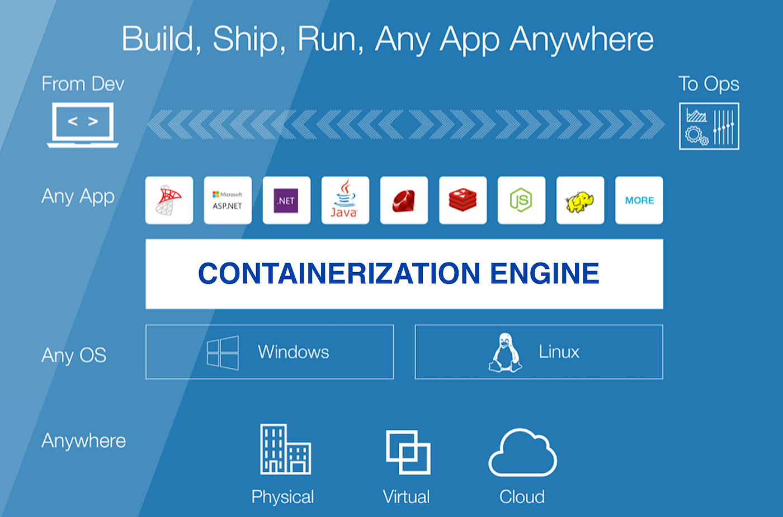
Containers
Isolated
Portability
Scalable
Much more
Notes:
https://medium.com/hackernoon/what-is-containerization-83ae53a709a6

Slide 28
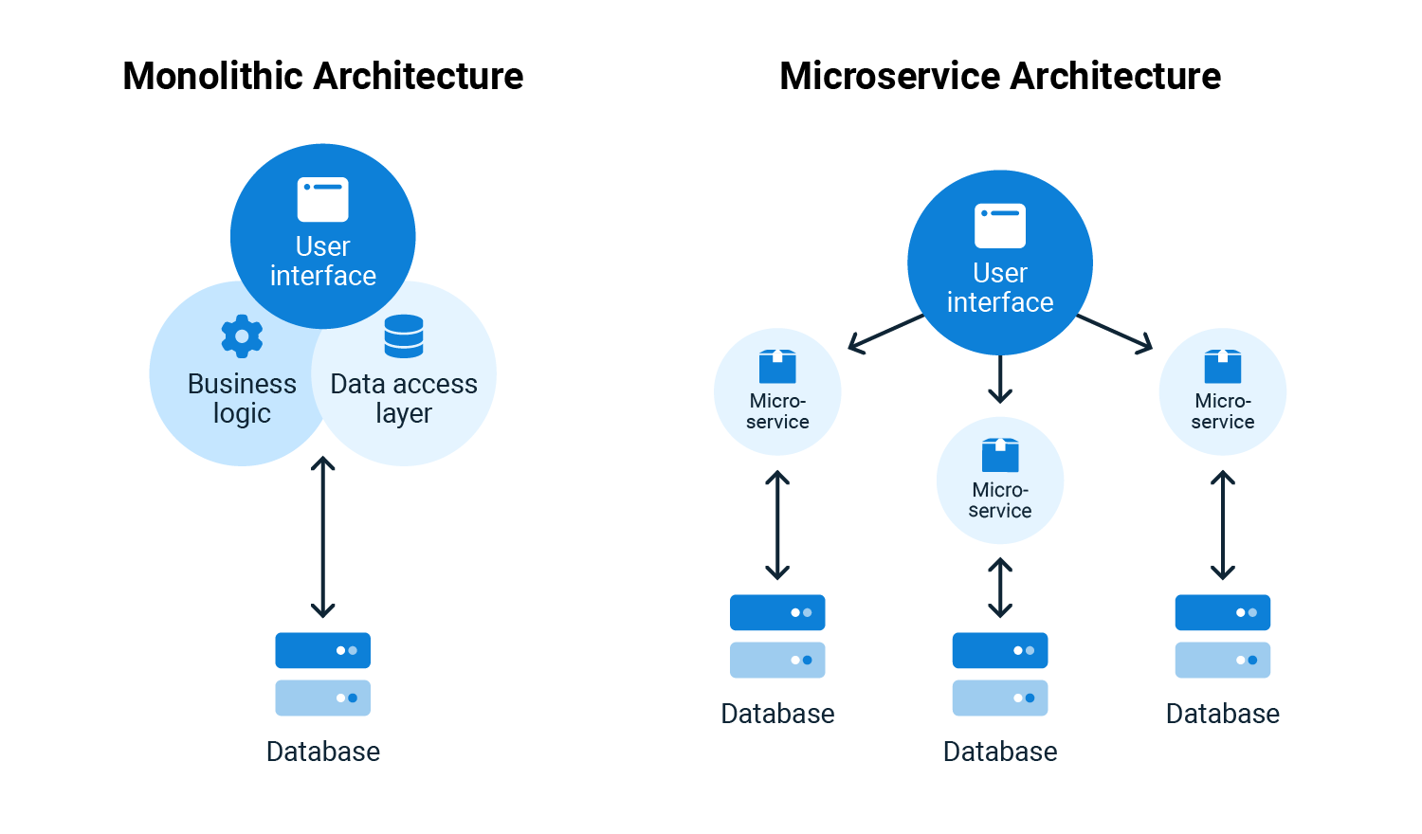
Microservices
Small, quick, decoupled
Often deployed in containers
Often leverages DDD (domain driven design)
Notes:
https://octopus.com/blog/monoliths-vs-microservices

Slide 29
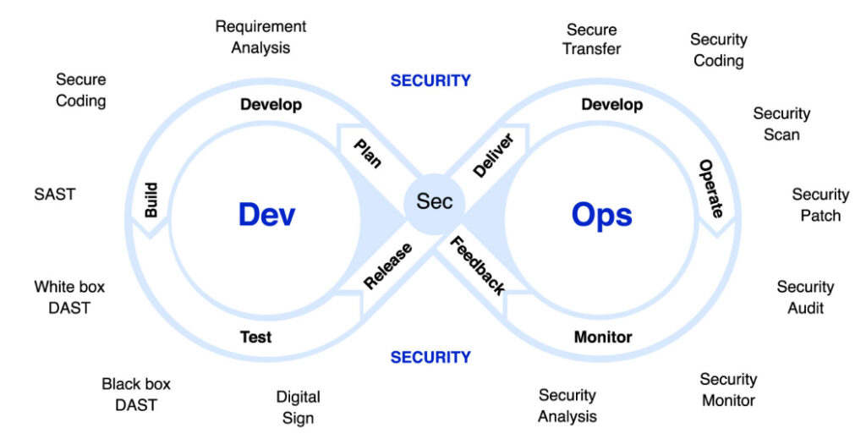
Automation / DevSecOps
Notes:
Image source: https://amazic.com/practical-advise-for-devsecops/

Slide 30
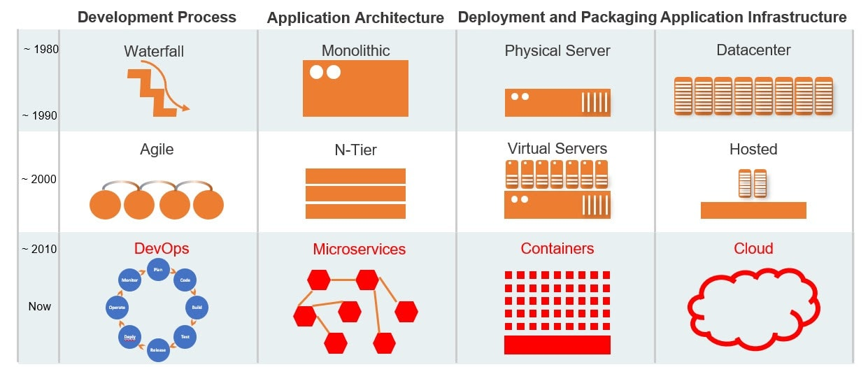
Evolution of Applications
<need to weed this out>
Cobol, Assembly, Fortran
Monolithic
N-Tier Architecture
Service-Oriented Architecture
Microservices / Containerization
Serverless
?
Notes:
https://k21academy.com/docker-kubernetes/monolithic-vs-microservices/

Slide 31
Getting Started

Slide 32

Key Principles for Success
Business Alignment
Comprehensive Assessment
User-Centric
Incremental Approach
Cross-Functional Collaboration
Up-to-date Technical Approach
Governance
Monitoring/Metrics
Documentation
Risk Management

Slide 33
How to get started
Identify challenge
Focus on business outcomes
Define modernization strategy
Determine success metrics
Conduct risk assessment
Start small
Consider leveraging a partner

Slide 34

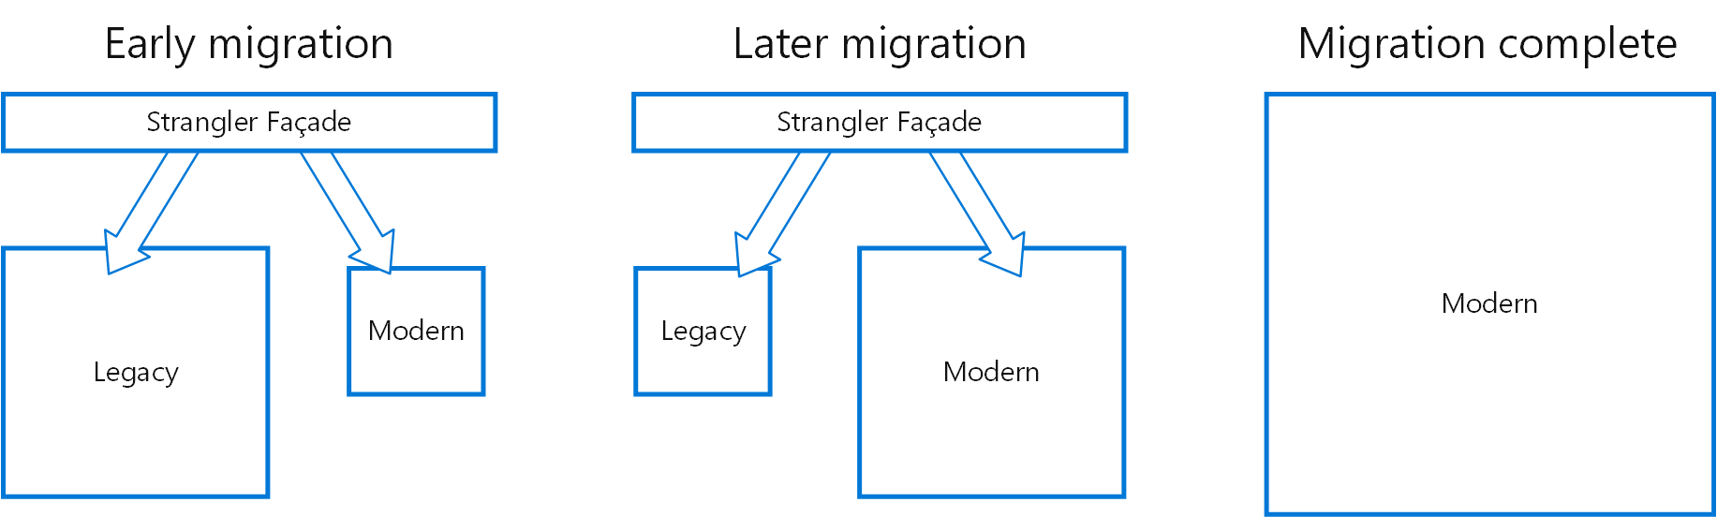
Strangler Fig Pattern
Notes:
https://learn.microsoft.com/en-us/azure/architecture/patterns/strangler-fig

Slide 35
Common Obstacles
Resistance to change
Limited resources
Legacy complexity
Scope creep
Unrealistic Expectations

Slide 36
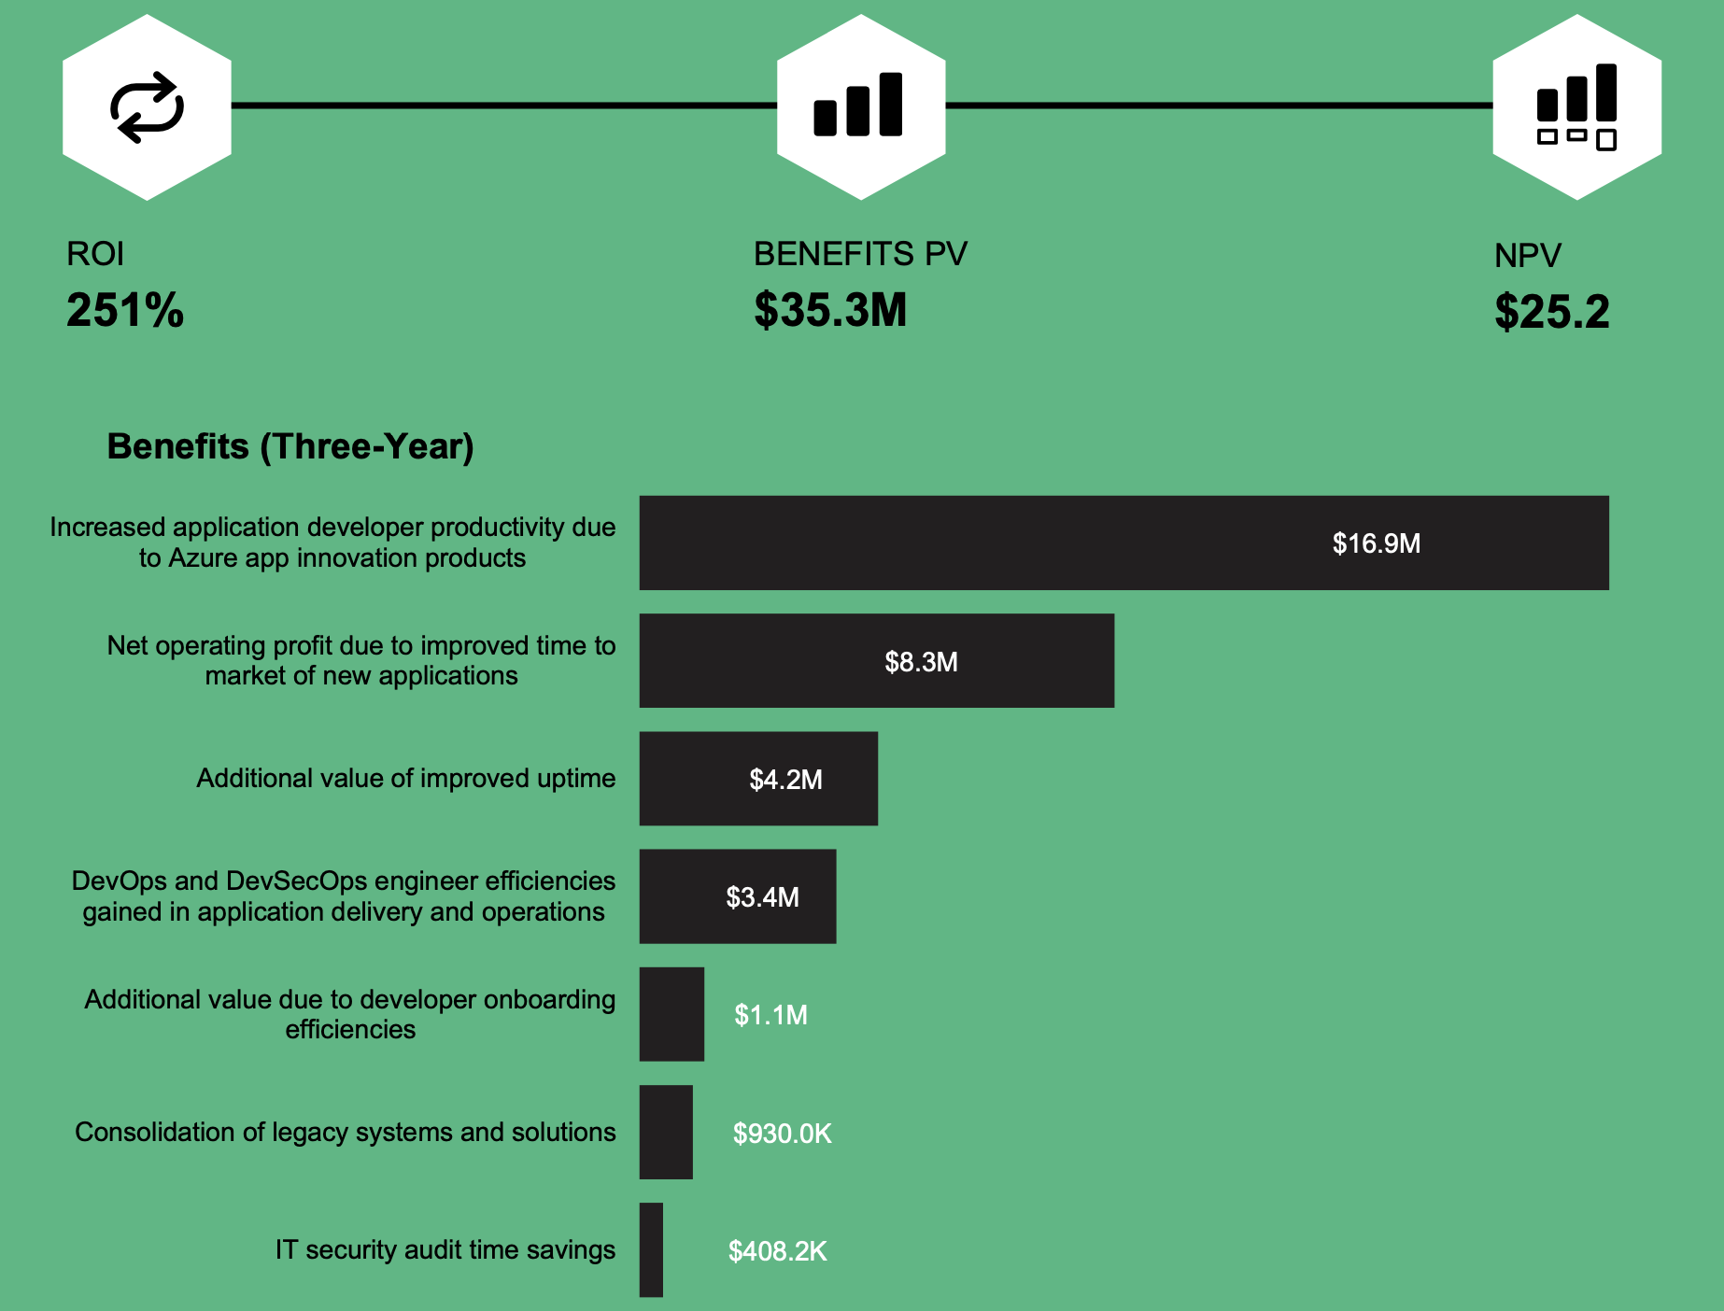
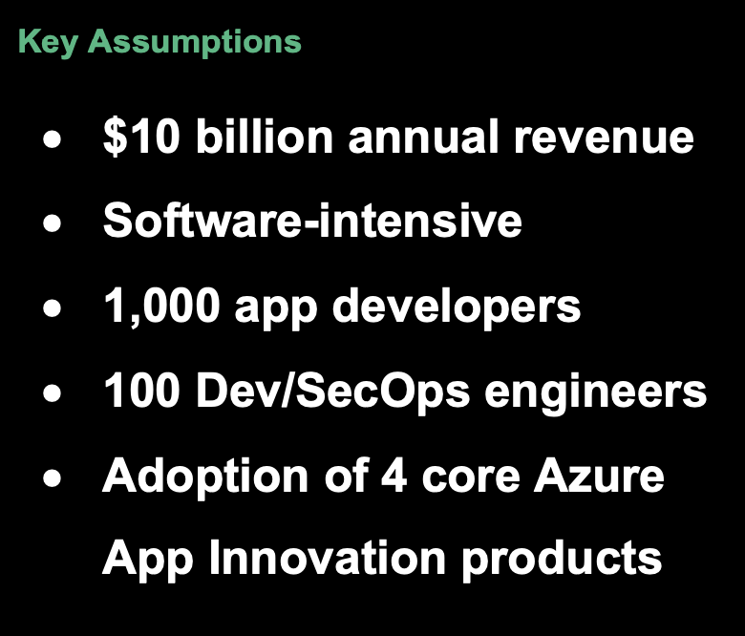
Case Study
Microsoft +
Forrester Consulting
Notes:
Source: “The Total Economic Impact Of Microsoft Developer Tools And Cloud Services,” a commissioned study conducted by Forrester Consulting on behalf of Microsoft, June 2021.
https://azure.microsoft.com/en-us/resources/

Slide 37
Overcoming Challenges

Slide 38
Common Obstacles
Resistance to change
Limited resources
Legacy complexity
Scope creep
Unrealistic Expectations

Slide 39
Strategies for Mitigating Risk

Slide 40
Lessons from Real-World Projects

Slide 41
Recap

Slide 42
Key Takeaways
Understand the importance
Identify the challenges
Define the strategy
Plan for the obstacles
Start small

Slide 43
Strategy and Approach
Rehost
Replatform
Refactor
Replace
Retire
Cloud Computing
Automation / DevSecOps
Containers
Microservices
AI / ML

Slide 44

Other things to consider
Team and practices evolution

Slide 45
Call for Action

Slide 46
Questions? Comments? Heckling?

Slide 47
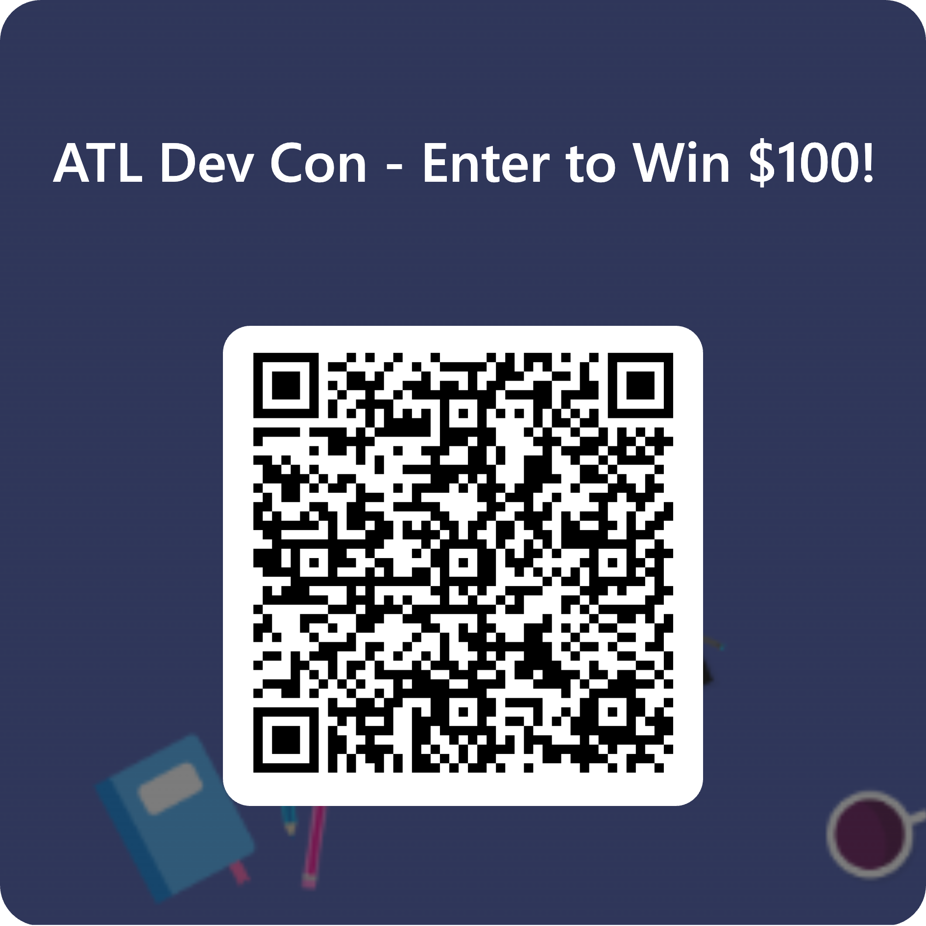
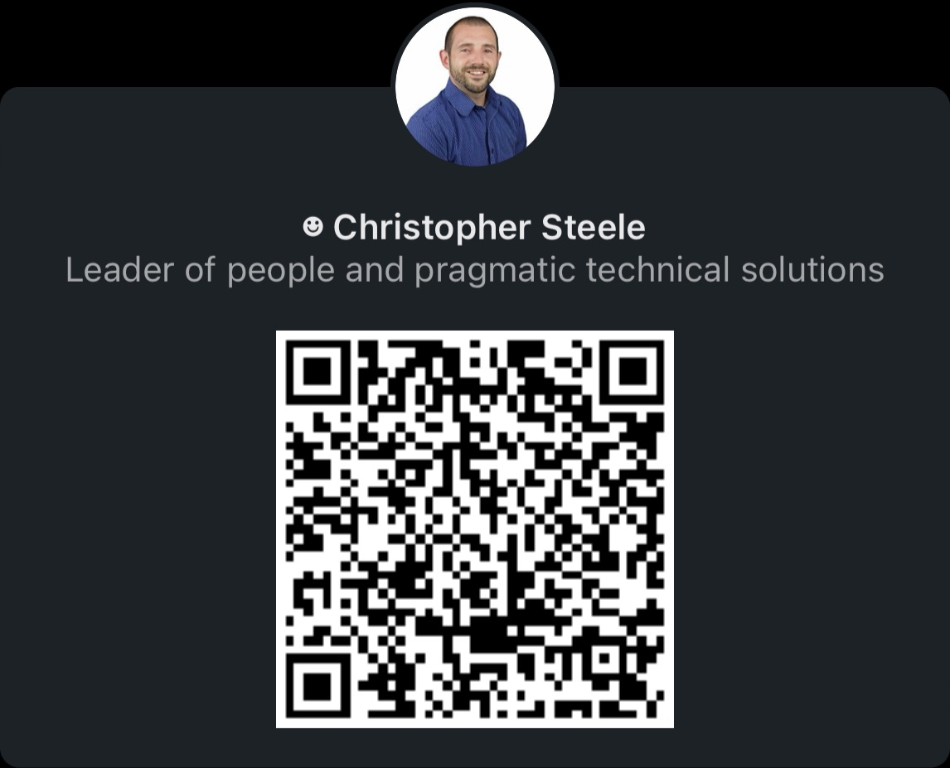
Thank you for joining my talk!

